Slide 1

6.Introducing Classes
Sisoft Technologies Pvt Ltd
SRC E7, Shipra Riviera Bazar, Gyan Khand-3, Indirapuram, Ghaziabad
Website: www.sisoft.in Email:info@sisoft.in
Phone: +91-9999-283-283

Slide 2
Classes
A class is a collection of fields (data) and methods (procedure or function) that operate on that data.
Circle
centre
radius
circumference()
area()

Slide 3
Classes
A class is a collection of fields (data) and methods (procedure or function) that operate on that data.
The basic syntax for a class definition:
Bare bone class – no fields, no methods
  class ClassName [extends SuperClassName]
  {
    [fields declaration]
    [methods declaration]
}
public class Circle {
// my circle class
}

Slide 4
Adding Fields: Class Circle with fields
Add fields
The fields (data) are also called the variables.
public class Circle {
public double x, y; // centre coordinate
public double r; // radius of the circle
}

Slide 5
Methods
A method is a set of code which is referred to by name and can be called (invoked) at any point in a program simply by utilizing the method's name.
Think of a method as a subprogram that acts on data and often returns a value.Each method has its own name.
When that name is encountered in a program, the execution of the program branches to the body of that method.
When the method is finished, execution returns to the area of the program code from which it was called,

Slide 6
Methods Declaration
Modifiers—such as public, private, and others
The return type—the data type of the value returned by the method, or void if the method does not return a value.
The method name—the rules for field names apply to method names as well, but the convention is a little different.
The parameter list in parenthesis—a comma-delimited list of input parameters, preceded by their data types, enclosed by parentheses, (). If there are no parameters, you must use empty parentheses.
An exception list
The method body, enclosed between braces—the method's code, including the declaration of local variables, goes here.

Slide 7
Adding Methods
A class with only data fields has no life. Objects created by such a class cannot respond to any messages.
Methods are declared inside the body of the class but immediately after the declaration of data fields.
The general form of a method declaration is:
type MethodName (parameter-list)
{
Method-body;
}

Slide 8
Method Types
Built-in: Build-in methods are part of the compiler package, such as System.out.println( ) and System.exit(0).
User-defined: User-defined methods are created by you, the programmer. These methods take-on names that you assign to them and perform tasks that you create.
int number = abcObj.add(4,6);

Slide 9
Variables in Java:
  Instance Variables (Non static variables)
  Class Variables (Static Variables)
  Local Variables

Slide 10
1.Instance variables :
Instance variables are declared in a class, but outside a method, constructor or any block.
When a space is allocated for an object in the heap a slot for each instance variable value is created.
Instance variables are created when an object is created with the use of the key word 'new' and destroyed when the object is destroyed.
Instance variables hold values that must be referenced by more than one method, constructor or block, or essential parts of an object state that must be present through out the class.
Instance variables can be declared in class level before or after use.
Access modifiers can be given for instance variables.

Slide 11
2.Class/static variables :
Class variables also known as static variables are declared with the static keyword in a class, but outside a method, constructor or a block.
There would only be one copy of each class variable per class, regardless of how many objects are created from it.
Static variables are rarely used other than being declared as constants. Constants are variables that are declared as public/private, final and static. Constant variables never change from their initial value.
Static variables are stored in static memory. It is rare to use static variables other than declared final and used as either public or private constants.

Slide 12
2.Class/static variables
Static variables are created when the program starts and destroyed when the program stops.
Visibility is similar to instance variables. However, most static variables are declared public since they must be available for users of the class.
Default values are same as instance variables. For numbers the default value is 0, for Booleans it is false and for object references it is null. Values can be assigned during the declaration or within the constructor. Additionally values can be assigned in special static initializer blocks.
Static variables can be accessed by calling with the class name . ClassName.VariableName.
When declaring class variables as public static final, then variables names (constants) are all in upper case. If the static variables are not public and final the naming syntax is the same as instance and local variables.

Slide 13
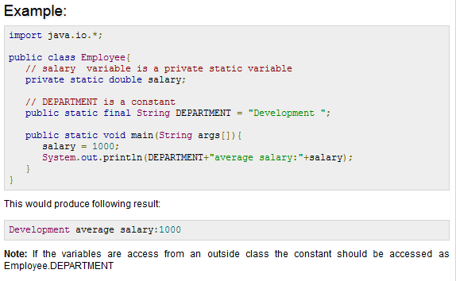

Slide 14
3. Local variables
  Local variables are declared in methods, constructors, or blocks.
  Local variables are created when the method, constructor or block is entered and the variable will be destroyed once it exits the method, constructor or block.
  Access modifiers cannot be used for local variables.
  Local variables are visible only within the declared method, constructor or block.
  Local variables are implemented at stack level internally.
  There is no default value for local variables so local variables should be declared and an initial value should be assigned before the first use.

Slide 15
Local variables Ex :
public class Test
{
  public void pupAge()
  {
    int age = 0;
    age = age + 7;
  System.out.println("Puppy age is : " + age);
  }
public static void main(String args[])
{
Test test = new Test(); test.pupAge();
} }
This would produce following result:
Puppy age is: 7

Slide 16
Constructors
A java constructor has the same name as the name of the class to which it belongs
Constructor’s syntax does not include a return type, since constructors never return a value.
Constructor is called when the new keyword is used
When no explicit constructors are provided. Java provides a default constructor which takes no arguments and performs no special actions or initializations
Constructors may include parameters of various types. When the constructor is invoked using the new operator, the types must match those that are specified in the constructor definition.

Slide 17
Constructors - Example
  Default Constructor
  Circle C1
  C1 = new Circle() ;
Defining Construtor
  Circle(int r)
  {
  }

Slide 18
Access and Non Acc Modifiers
Modifiers are keywords that you add to those definitions to change their meanings
The Java language has a wide variety of modifiers, including the following:
  Java Access Modifiers
  Non Access Modifiers
To use a modifier, you include its keyword in the definition of a class, method, or variable. The modifier precedes the rest of the statement

Slide 19
Access and Non Acc Modifiers
public class className { // ... } private boolean myFlag;
static final double weeks = 9.5; protected static final int BOXWIDTH = 42;
public static void main(String[] arguments) {
// body of method }

Slide 20
Access Control Modifiers:
Java provides a number of access modifiers to set access levels for classes, variables, methods and constructors. The four access levels are:
Visible to the package, the default. No modifiers are needed.
Visible to the class only (private).
Visible to the world (public).
Visible to the package and all subclasses (protected).

Slide 21
Non Access Modifiers:
Java provides a number of non-access modifiers to achieve many other functionality.
The static modifier for creating class methods and variables
The final modifier for finalizing the implementations of classes, methods, and variables.
The abstract modifier for creating abstract classes and methods.
The synchronized and volatile modifiers, which are used for threads.

Slide 22
Static
Static variable
Static Class
Static method

Slide 23
static Variables
Java instance variables are given separate memory for storage. If there is a need for a variable to be common to all the objects of a single java class, then the static modifier should be used in the variable declaration.
Any java object that belongs to that class can modify its static variables.
Also, an instance is not a must to modify the static variable and it can be accessed using the java class directly.
Static variables can be accessed by java instance methods also.
When the value of a constant is known at compile time it is declared ‘final’ using the ‘static’ keyword.

Slide 24
static Methods
Similar to static variables, java static methods are also common to classes and not tied to a java instance.
Good practice in java is that, static methods should be invoked with using the class name though it can be invoked using an object. ClassName.methodName(arguments) or objectName.methodName(arguments)
General use for java static methods is to access static fields.
Static methods can be accessed by java instance methods.
Java static methods cannot access instance variables or instance methods directly.
Java static methods cannot use the ‘this’ keyword

Slide 25
static Blocks
Static blocks are also called Static initialization blocks . A static initialization block is a normal block of code enclosed in braces, { }, and preceded by the static keyword. Here is an example:
static {
// whatever code is needed for initialization goes here
}
Static blocks are executed when JVM loads the class
if you miss to precede the block with "static" keyword, the block is called "constructor block" and will be executed when the class is instantiated. The constructor block will be copied into each constructor of the class.

Slide 26
static Classes
static Classes
For java classes, only an inner class can be declared using the static modifier.
For java a static inner class it does not mean that, all their members are static. These are called nested static classes in java.

Slide 27
final Fields
A field can be declared final
Both class and instance variables (static and non-static fields) may be declared final.
Effectively final declares the variable to be constant
Example:
private final int PERFECT_SCORE = 100

Slide 28
final Methods
A final method cannot be overridden or hidden by subclasses.
This is used to prevent unexpected behavior from a subclass altering a method that may be crucial to the function or consistency of the class
public final void m2() {...}
public static final void m4() {...}

Slide 29
final class
To stop a class from being inherited from (sub-classes) we declare it as a final class e.g.
If Person was declared as final
final class Person {
...
// the body of the class
...
}

Slide 30
final class
Then the following would not be allowed:
class Programmer extends Person {
...
// the body of the class
...
}

Slide 31
Modifier – Abstract
Description
  Represents generic concept
  Can not be instantiated
Abstract class
  Placeholder in class hierarchy
  Can be partial description of class
  Can contain non-abstract methods
  Required if any method in class is abstract

Slide 32
Adding Methods to Class Circle
public class Circle {
public double x, y; // centre of the circle
public double r; // radius of circle
//Methods to return circumference and area
public double circumference() {
return 2*3.14*r;
}
public double area() {
return 3.14 * r * r;
}
}
Method Body

Slide 33
Method Overloading
Same method name, different type and/or number of parameters
Return types do not differentiate between overloaded methods
If no exact match found for methods, automatic type conversions will be applied to match the methods to be called
public class DataArtist { ...
  public void draw(String s) { ... }
  public void draw(int i) { ... }
  public void draw(double f) { ... }
  public void draw(int i, double f) { ... }
  }

Slide 34
Methods Using Variable Arguments
Java provides a feature, called varargs or variable arguments, which enables the programmers to write a more generic method that share the same functionality.
The following code snippet displays the use of variable arguments:
  public class Statistics {
  public float average(int... nums) {
  int sum = 0;
  for ( int x : nums ) {
  sum += x;
  }
  return ((float) sum) / nums.length;
  }

Slide 35
Legal and illegal vararg
Void doStuff(int…x){}
Void dostuff2(char c,int…x){}
Void doStuff3(Animal…anmRef)
Illegal
Void doStuff(int x…){}
Void dostuff2(int…x,char c){}
Void doStuff3(int…x, int…y)

Slide 36
Constructor Overloading
Like methods, constructors can also be overloaded
Constructor overloading allows you to declare multiple constructor

Slide 37
Constructor Chaining
Calling one constructor from other is called constructor chaining
this() can be used to call other constructor of same class
The this() call in a constructor invokes the an other constructor with the corresponding parameter list within the same class.
Java requires that any this() call must occur as the first statement in a constructor.

Slide 38
Garbage Collection
In Java, process of deallocating memory is handled automatically by the garbage collector
The garbage collection is the process of looking at heap memory, identifying which objects are in use and which are not, and deleting the unused objects
An in use object, or a referenced object, means that some part of your program still maintains a pointer to that object
An unused object, or unreferenced object, is no longer referenced by any part of your program. So the memory used by an unreferenced object can be reclaimed

Slide 39
Unreferencing Object
1) By nulling a reference:
  Employee e=new Employee();
  e=null;
2) By assigning a reference to another:
  Employee e1=new Employee();
  Employee e2=new Employee();
  e1=e2;//now the first object referred by e1 is available for garbage collection
3) By annonymous object:
  new Employee();

Slide 40
Garbage Collection: Methods
finalize() method:
The finalize() method is invoked each time before the object is garbage collected. This method can be used to perform cleanup processing. This method is defined in System class as:
  protected void finalize(){}
gc() method:
The gc() method is used to invoke the garbage collector to perform cleanup processing. The gc() is found in System and Runtime classes.
  public static void gc(){}

Slide 41
Wrapper classes

Slide 42
Wrapper classes
Java is an object-oriented language and can view everything as an object. A simple file can be treated as an object (with java.io.File), an address of a system can be seen as an object (with java.util.URL), an image can be treated as an object (with java.awt.Image) and a simple data type can be converted into an object (with wrapper classes).
The primitive data types are not objects; they do not belong to any class; they are defined in the language itself. Sometimes, it is required to convert data types into objects in Java language. For example, upto JDK1.4, the data structures accept only objects to store. A data type is to be converted into an object and then added to a Stack or Vector etc. For this conversion, the designers introduced wrapper classes

Slide 43
What is wrapper class :-
As the name says, a wrapper class wraps (encloses) around a data type and gives it an object appearance. Wherever, the data type is required as an object, this object can be used. Wrapper classes include methods to unwrap the object and give back the data type.
It can be compared with a chocolate. The manufacturer wraps the chocolate with some foil or paper to prevent from pollution. The user takes the chocolate, removes and throws the wrapper and eats it

Slide 44
Wrapper classes
The following conversion.
The int data type k is converted into an object, it1 using Integer class. The it1 object can be used in Java programming wherever k is required an object.
The following code can be used to unwrap (getting back int from Integer object) the object it1.
int k = 100;
Integer it1 = new Integer(k);
int m = it1.intValue();
System.out.println(m*m); // prints 10000
intValue() is a method of Integer class that returns an int data type.

Slide 45
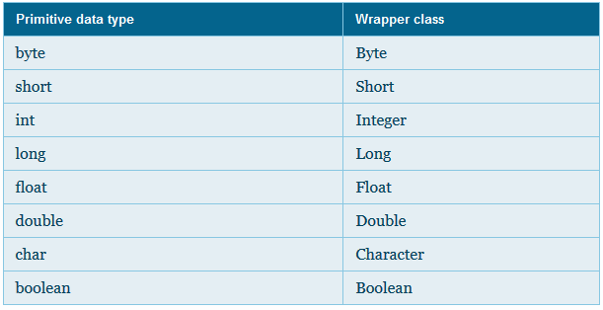
Wrapper classes
In the above code, Integer class is known as a wrapper class (because it wraps around a data type to give it an impression of object). To wrap (or to convert) each primitive data type, there comes a wrapper class. Eight wrapper classes exist in java.lang package that represent 8 data types.
List of Wrapper classes

Slide 46
Java
Numbers Class

Slide 47
Java Numbers Class
Normally, when we work with Numbers, we use primitive data types such as byte, int, long, double etc
int a = 5000;
float b = 13.65;
byte c= 0xaf;

Slide 48
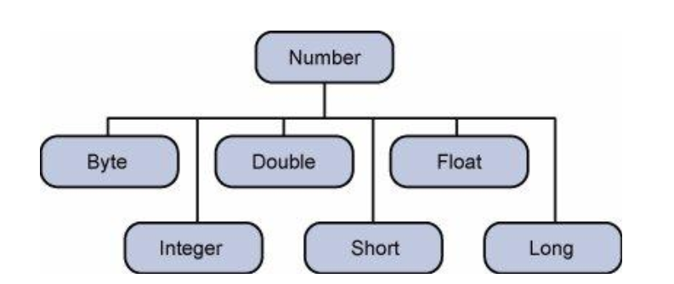
Java Numbers Class
However in development we come across situations were we need to use objects instead of primitive data types. In-order to achieve this Java provides wrapper classes for each primitive data type.
All the wrapper classes ( Integer, Long, Byte, Double, Float, Short) are subclasses of the abstract class Number.

Slide 49
Number Methods:
Method | Description
byte byteValue() short shortValue() int intValue() long longValue() float floatValue() double doubleValue() | Converts the value of this Number object to the primitive data type returned.
int compareTo(Byte anotherByte) int compareTo(Double anotherDouble) int compareTo(Float anotherFloat) int compareTo(Integer anotherInteger) int compareTo(Long anotherLong) int compareTo(Short anotherShort) | Compares this Number object to the argument.
boolean equals(Object obj) | Determines whether this number object is equal to the argument. The methods return true if the argument is not null and is an object of the same type and with the same numeric value. There are some extra requirements for Double and Float objects that are described in the Java API documentation.

Slide 50
Number (Conversion Methods) : Integer
Method | Description
static Integer decode(String s) | Decodes a string into an integer. Can accept string representations of decimal, octal, or hexadecimal numbers as input.
static int parseInt(String s) | Returns an integer (decimal only).
static int parseInt(String s, int radix) | Returns an integer, given a string representation of decimal, binary, octal, or hexadecimal (radix equals 10, 2, 8, or 16 respectively) numbers as input.
String toString() | Returns a String object representing the value of this Integer.
static String toString(int i) | Returns a String object representing the specified integer.
static Integer valueOf(int i) | Returns an Integer object holding the value of the specified primitive.
static Integer valueOf(String s) | Returns an Integer object holding the value of the specified string representation.
static Integer valueOf(String s, int radix) | Returns an Integer object holding the integer value of the specified string representation, parsed with the value of radix. For example, if s = "333" and radix = 8, the method returns the base-ten integer equivalent of the octal number 333.

Slide 51
Java
String Class

Slide 52
String
Strings, which are widely used in Java programming, are a sequence of characters. In the Java programming language, strings are objects.
The Java platform provides the String class to create and manipulate strings.
Creating Strings:
String greeting = "Hello sisoft!"

Slide 53
String Length:
public class Stringlength
{
public static void main(String args[])
{
String str= "Dot saw I was Tod";
int len = str.length();
System.out.println( "String Length is : " + len );
} }

Slide 54
Concatenating Strings:
Sting str1=“hello”;
String str2=“sisoft”;
String str=string1.concat(string2);
SOP(str);
Converting Numbers to Strings
int i=68;
String s2 = String.valueOf(i); // The valueOf class method.
Converting Strings to Numbers

Slide 55
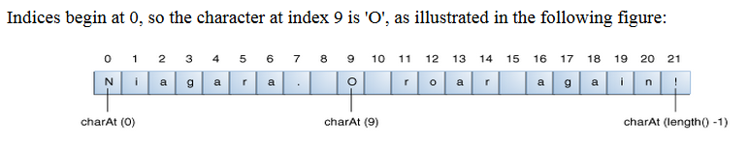
Getting Characters and Substrings by Index
char aChar = str.charAt(9);

Slide 56
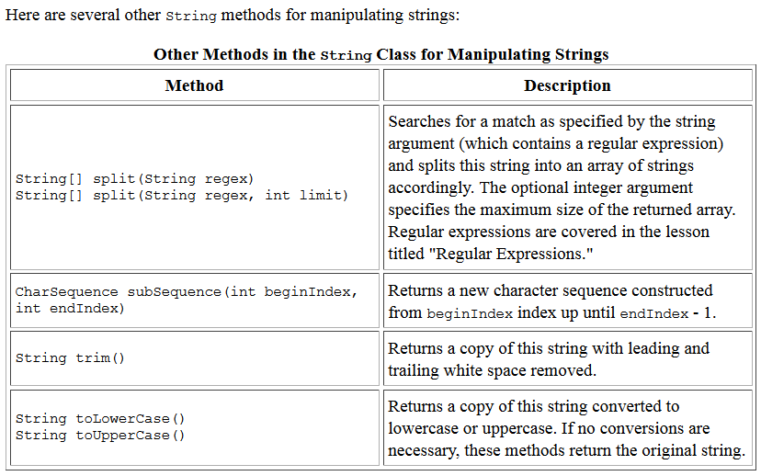

Slide 57
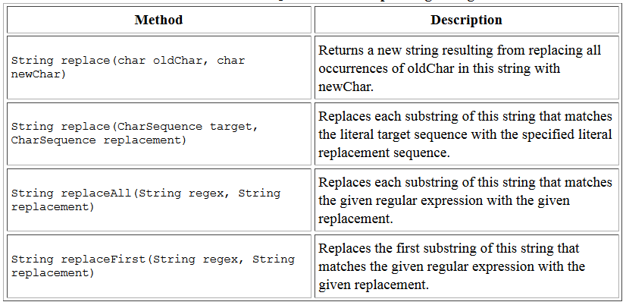
Replacing Characters and Substrings into a String

Slide 58
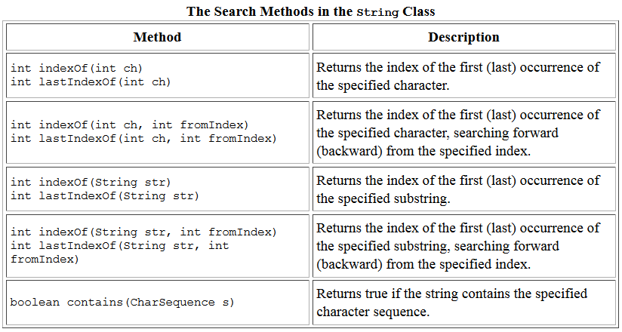
Searching for Characters and Substrings in a String

Slide 59
StringBuilder and StringBuffer
These are mutable form of String and contain methods which make String processing easy
StringBuffer class is exactly the same as the StringBuilder class
Each method in StringBuffer is synchronized hence StringBuffer is thread safe .
StringBuilder is also not thread safe

Slide 60
String, StringBuilder & StringBuffer
------------------------------------------------------------------------
String StringBuffer StringBuilder
------------------------------------------------------------------------
Storage Area| Constant String Heap Heap
Pool
Modifiable | No (immutable) Yes(mutable) Yes(mutable)
Thread safee | Yes Yes No
Performance | Fast Very slow Fast
------------------------------------------------------------------------

Slide 61
Autoboxing and UnBoxing
Autoboxing is the automatic conversion that the Java compiler makes between the primitive types and their corresponding object wrapper classes.
For example, converting an int to an Integer, a double to a Double, and so on.
If the conversion goes the other way, this is called unboxing.
Here is the simplest example of autoboxing:
  Character ch = 'a';
  Integer i1 = 22 ;

